Slide 1

Selecting Candidates to Provide Optimum Business Success ADS-502 Applied Data Mining
By: Omar Elfeky, Isabella T Oakes, and Ashutosh Singh

Slide 2
Table of contents
Business goal
Flowchart of Information Discovery
Data Exploration
Data mining method
Performance metrics
Data mining result

Slide 3
Business goal
To determine which candidates that sign up for the courses will go on to work for the company, and which are likely to stay at their current jobs.
By determining which candidates are most likely to work for the company, the time and money for the courses can be allocated only to candidates most likely to go on to work for the company.

Slide 4
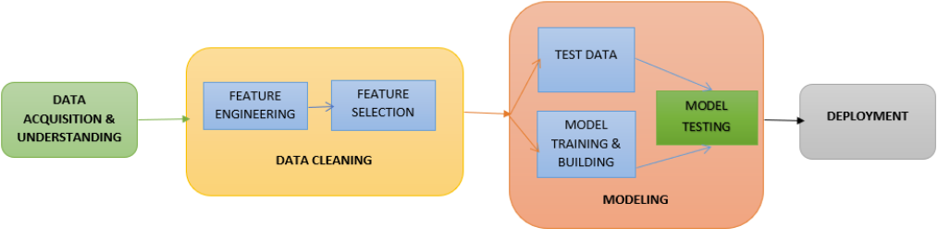
Flowchart of Information Discovery

Slide 5
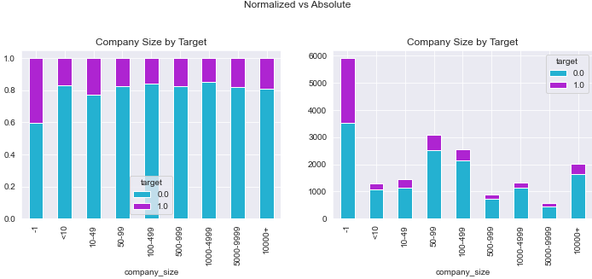
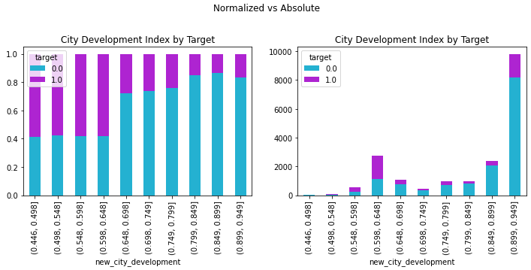
Data exploration
How data are correlated are shown with 4 figures using correlation and scatter matrix.
Figure 1
Figure 2
Fig 1: Company Size Normalized and Absolute Distributions. Fig 2: City Development Index Normalized and Absolute Distributions

Slide 6
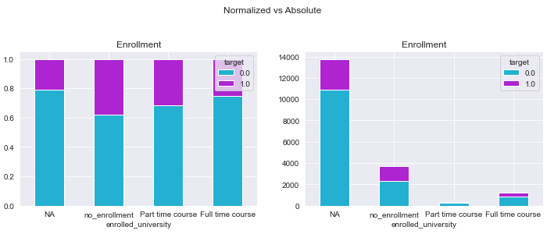
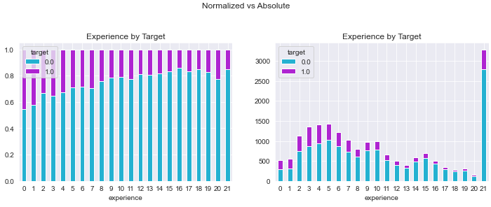
Data exploration
Figure 3
Figure 4
Fig 3: Enrollment Normalized and Absolute Distributions. Fig 4: Experience Normalized and Absolute Distributions

Slide 7
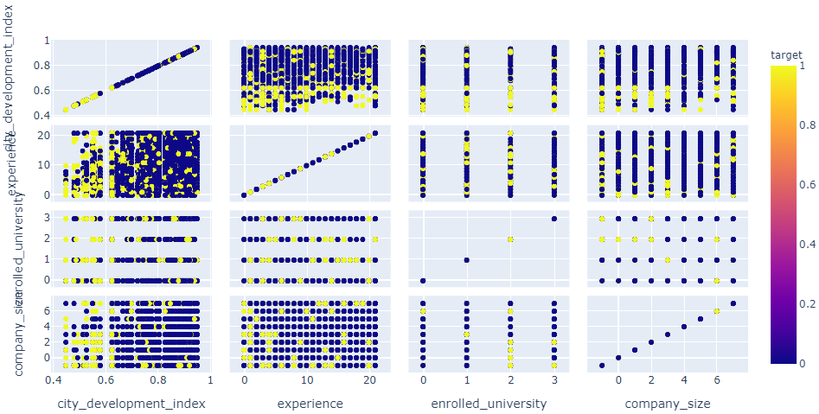
Data exploration
Scatter Matrix for City Development Index, Experience, University Enrollment, and Company Size

Slide 8
Data mining method
We used 4 models:
Logistical regression model
Random Forest
Naïve Bayes
CART5.0 decision tree

Slide 9

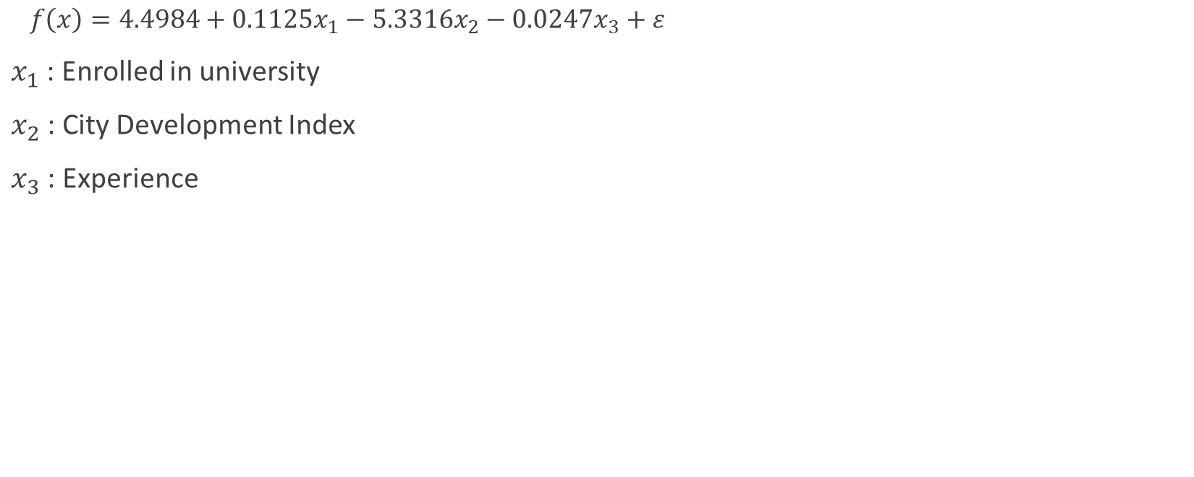
Logistical Regression Model
$f\left(x\right)=4.4984+0.1125x_{1}−5.3316x_{2}−0.0247x_{3}+ε$
$x_{1}$ : Enrolled in university
$x_{2}$ : City Development Index
$x_{3}$ : Experience

Slide 10
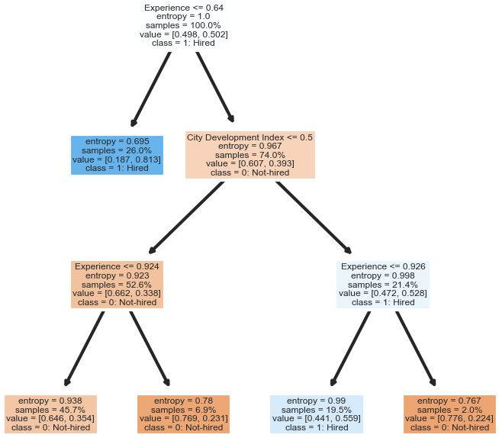
CART5.0 Decision tree
Cart5.0 Decision Tree of Target Using University Enrollment, City Development Index, and Experience
Notes:
CART stands for Classification and Regresstion Tree.
It constructs binary trees using the feature and threshold that yields the largest information gain at each node.

Slide 11
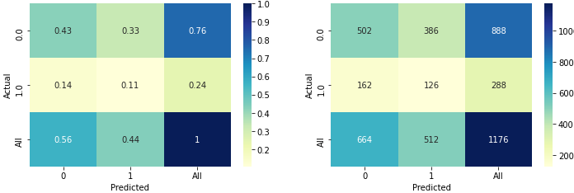
Performance Metrics
Confusion matrix for Logistical Regression Model (Normalized and Absolute)
Figure 1

Slide 12
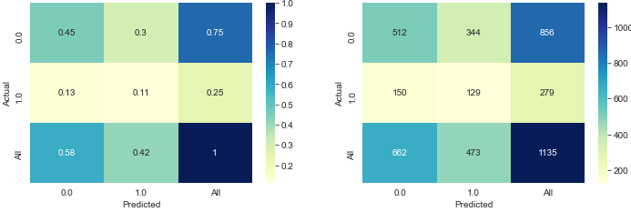
Performance Metrics
Confusion matrix for Random Forest Model (Normalized and Absolute)
Figure 2

Slide 13
Performance Metrics
Confusion Matrix for Naïve Bayes Model (Normalized and Absolute)
Figure 3

Slide 14

Performance Metrics
Confusion matrix for Cart5.0 Decision Tree (Normalized and Absolute)
Figure 4

Slide 15
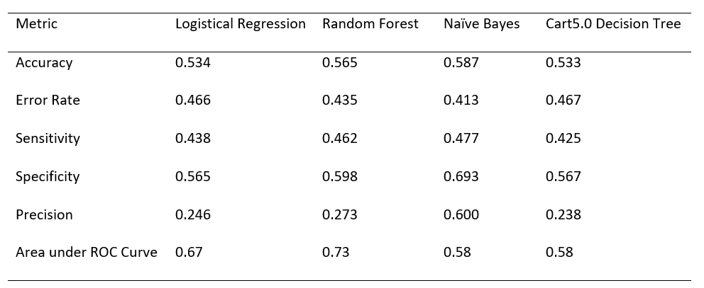
Data mining result
Based on the below table, Naïve Bayes model had the highest sensitivity, so would be the ideal choice.

Slide 16
Reference
HR Analytics: Job Change of Data Scientists. (2021, January). https://www.kaggle.com/arashnic/hr-analytics-job-change-of-data-scientists

Slide 17
Thank you

